Slide 1
Identifying Valuable Trade Assets
For the Orlando Magic
Based on Predicted WAR
Researched and Presented
by Andrew Cafiero

Slide 2
The problem
Lack of star
Offense is lacking
Star power is winning power. A nucleus to the greater cell is essential for successful results. In this same way, a veteran presence will help bring about empirical change.
Without a plan and someone to work the offense around, key offensive metrics will continue to stagnate. We need someone who is a proven winner to set the right direction.

Slide 3
The Data

Slide 4
Wins Above Replacement
Robust Algorithm using Player Tracking and On/Off Ratings
Player Impact of Team Possessions per 48min
WAR
PREDATOR
RAPTOR
On/Off
PACE
Predictive points above average
Points above average with Plus/Minus

Slide 5
“Next WAR”
aka Predicted Wins above Replacement going into next season

Slide 6
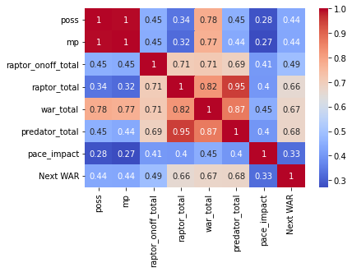

Slide 7
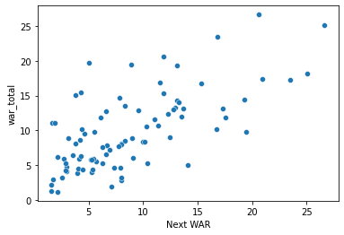
Last Year’s WAR vs Predicted WAR Next Season

Slide 8
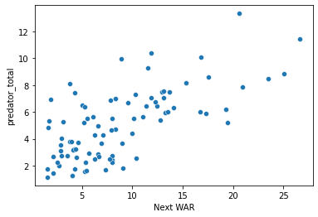
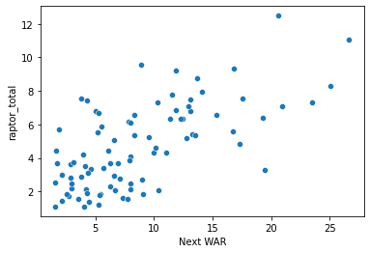
RAPTOR Totals vs Predicted WAR Next Season
Predator Totals vs Predicted WAR Next Season

Slide 9
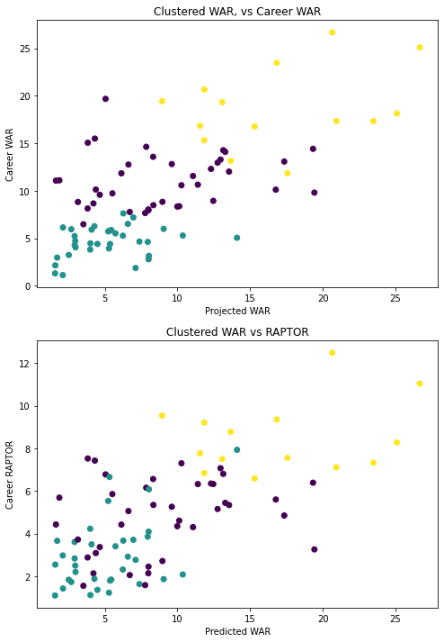
Our Model
Based on Predicted WAR and RAPTOR, we were able to produce 89% accurate predictions for the WAR of the athletes going into next year.

Slide 10
The Regression
STRENGTHS
WEAKNESSES
Easier to understand what stat-based numbers are required of a player
We can find a range of prospects rather than one “most ideal” athlete
We can clearly see the more a bolsters their RAPTOR and Predator scores, the more likely they are to have a high WAR in a simulated year
We can only use the data that is able to “fit”
Can be a slow process and we know time is money
Not the most optimal model when compared to other model

Slide 11
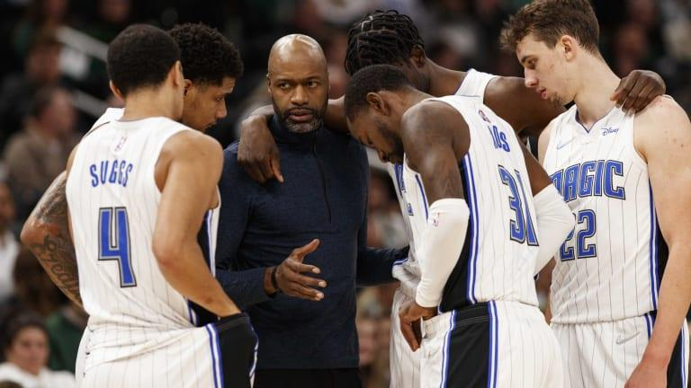
Result
There are potentially high value trade targets across the league and to secure the future to the franchise, we know where to start to look.

